Slide 1
生物统计和生物信息引论
Lecture 11
生成模型
王健桥
jianqw@mail.tsinghua.edu.cn

Slide 2
Generative Models Overview

Slide 3
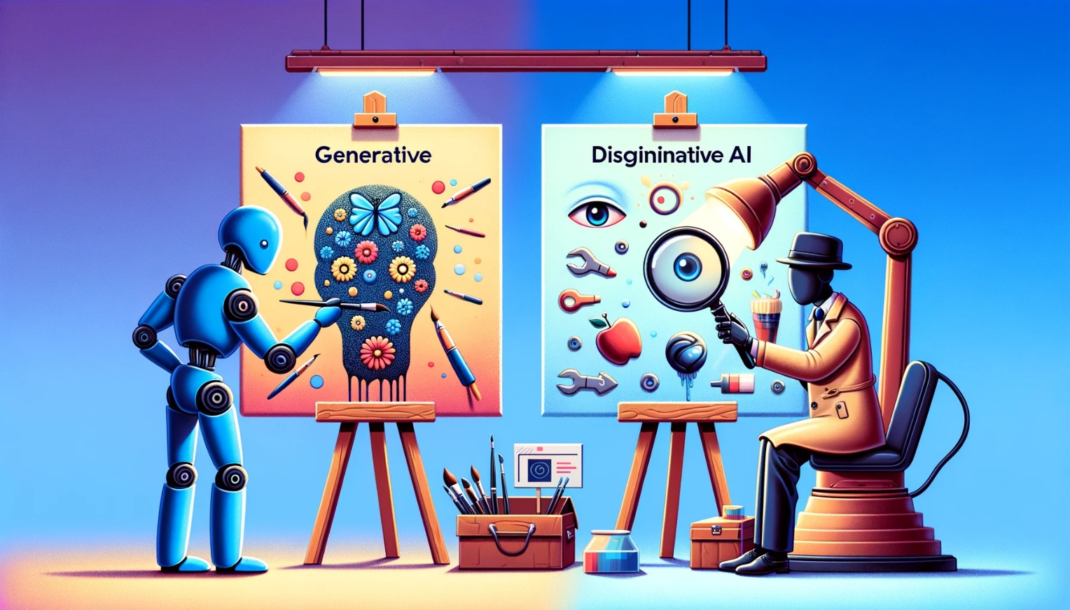
What is generative model？
Generative: creative new data or understand the data. Examples: draw.
Discriminative: classify the data or recognize the data. Examples: see.

Slide 4
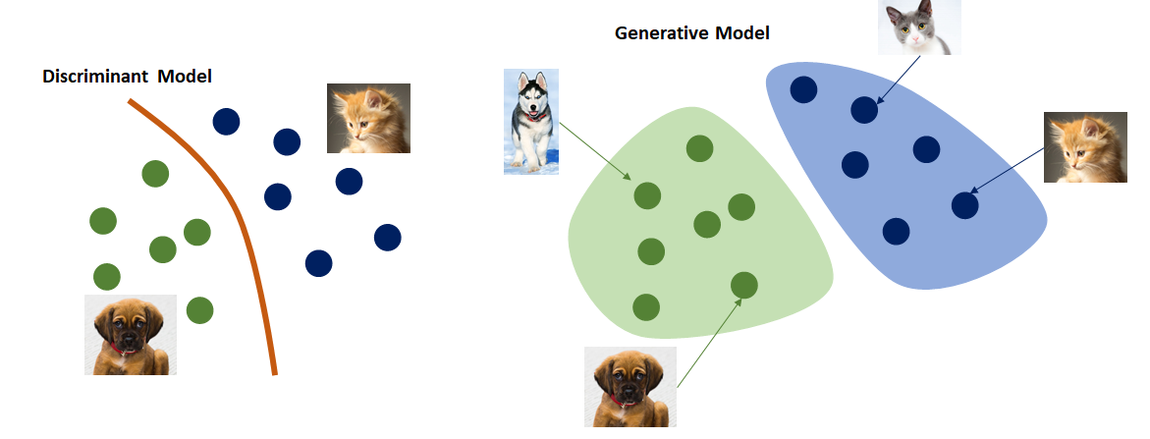
Discriminative Model v.s. Generative Model
Learn a mapping from input to output (function fitting)
Learn distribution of data (distribution fitting)
Discriminative
Generative

Slide 5
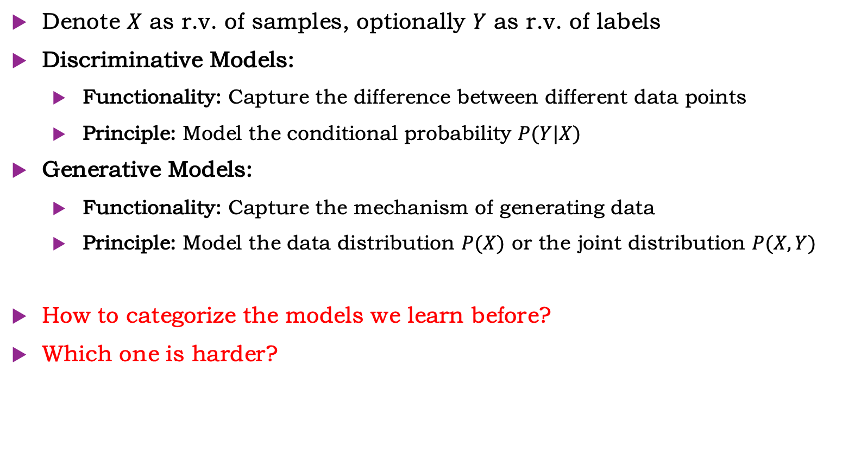
Discriminative Model v.s. Generative Model
Denote $X$ as r.v. of samples, optionally $Y$ as r.v. of labels
Discriminative Models:
  Functionality: Capture the difference between different data points
  Principle: Model the conditional probability $P(Y|X)$
Generative Models:
  Functionality: Capture the mechanism of generating data
  Principle: Model the data distribution $P(X)$ or the joint distribution $P(X, Y)$
How to categorize the models we learn before?
Which one is harder?

Slide 6
Why generative model?
What I cannot create, I do not understand.
--Richard Feynman
Model data distribution means a deeper understanding than classification.
That lets them generate, complete, denoise, simulate……

Slide 7
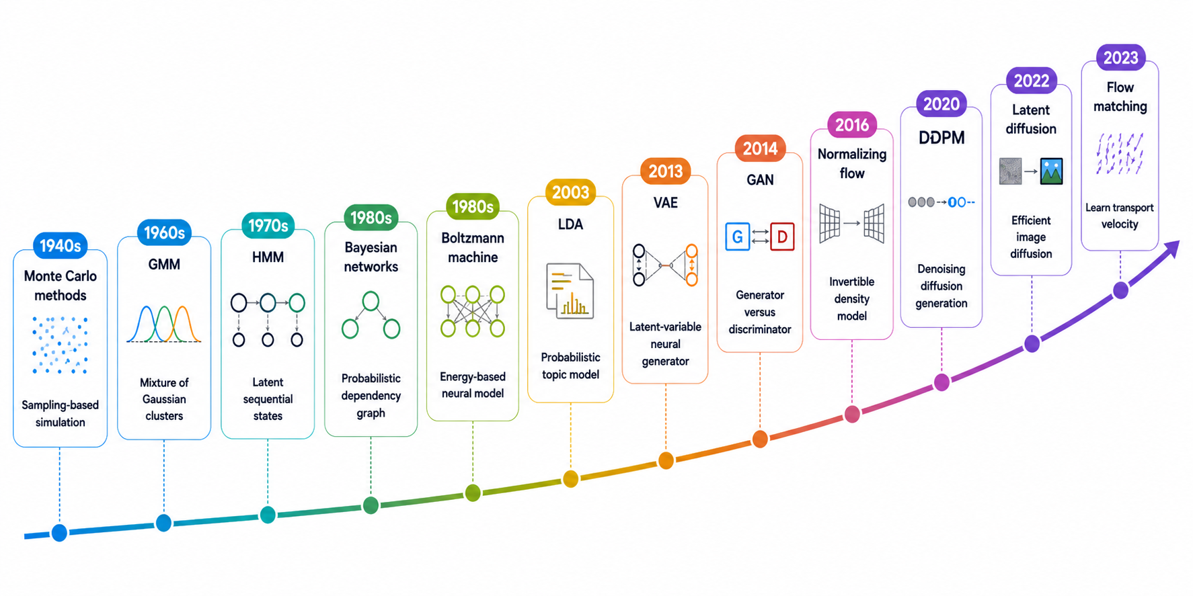
Timeline

Slide 8
Variational Auto Encoder(VAE)

Slide 9
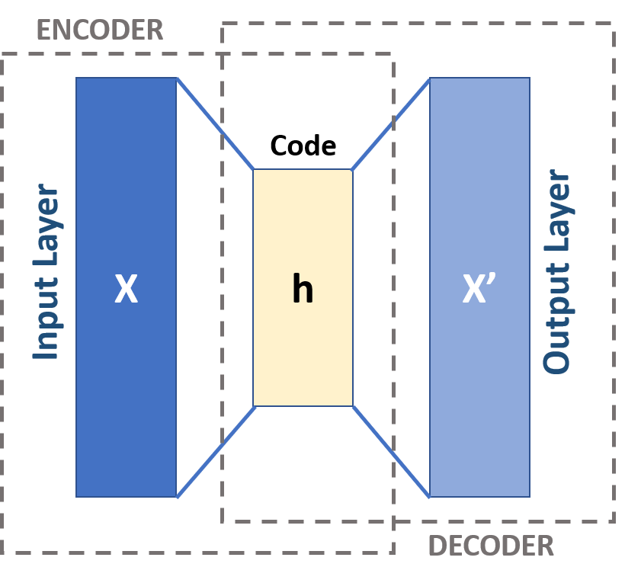
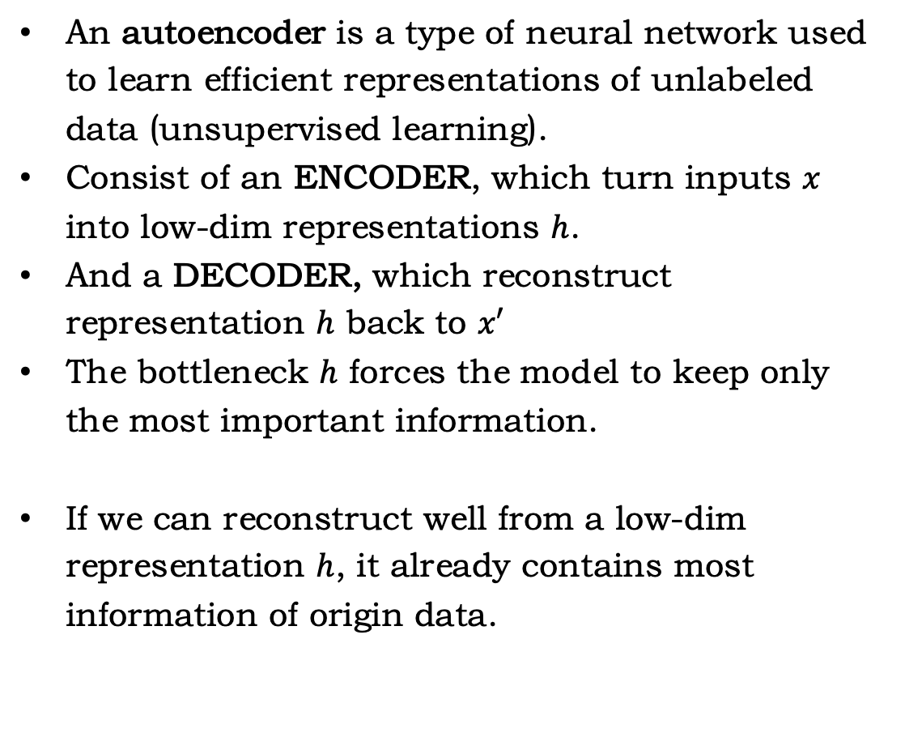
Auto Encoder
An autoencoder is a type of neural network used to learn efficient representations of unlabeled data (unsupervised learning).
Consist of an ENCODER, which turn inputs $x$ into low-dim representations $h$.
And a DECODER, which reconstruct representation $h$ back to $x′$
The bottleneck $h$ forces the model to keep only the most important information.
If we can reconstruct well from a low-dim representation $h$, it already contains most information of origin data.
Source: https://en.wikipedia.org/wiki/Autoencoder

Slide 10
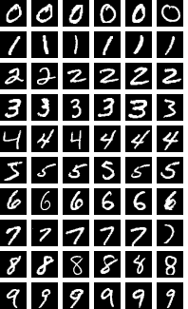
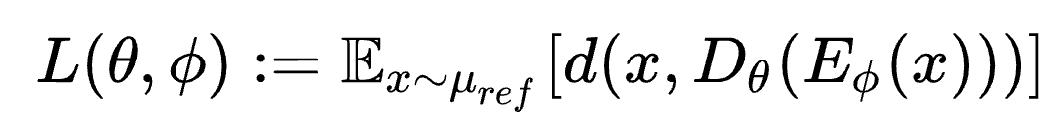
How to train an AE?
Choose a dataset, e.g. MNIST. It is a very famous hand-written dataset constructed by Yann LeCun.
Each figure is 28*28 (can be regarded as 768-dim vector), and each pixel is a number in [0,1].
Use NN as encoder and decoder. We start from 2-layer MLP.
Choose optimization goal: MSE for reconstruction.
Start training.
After training, we can use the encoder to generate representation for new images(yes, we don’t need the decoder).
Code: https://www.kaggle.com/code/shivamkc3/linear-autoencoder-using-pytorch-part-01

Slide 11
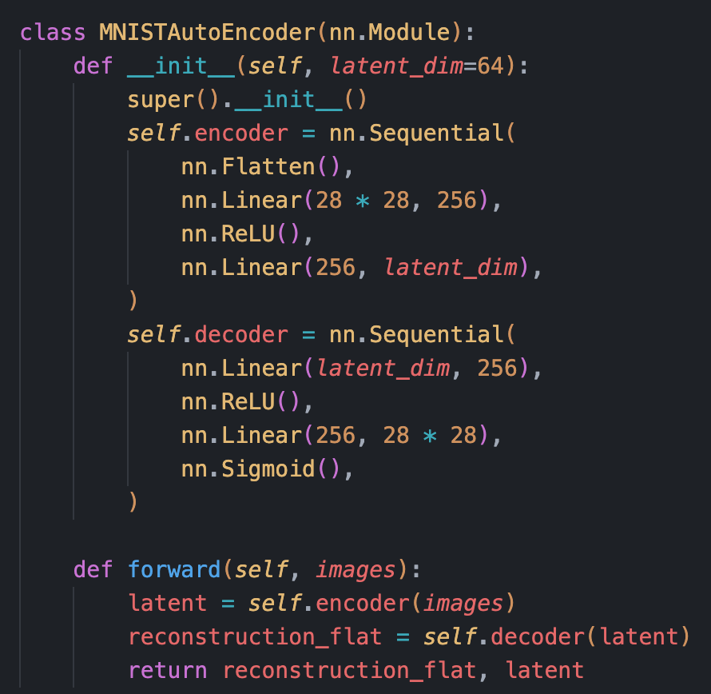
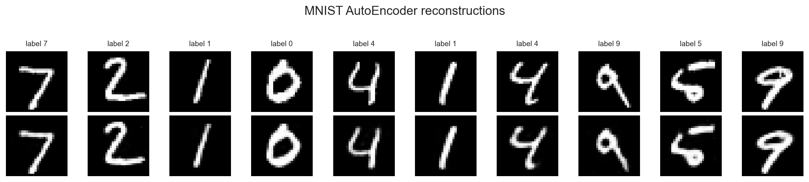
How to train an AE?
64-dim representation.
It’s an easy task, so reconstruction looks good.
The first row is real image, the second is reconstructions
Should converge within minutes
Code: https://www.kaggle.com/code/shivamkc3/linear-autoencoder-using-pytorch-part-01

Slide 12
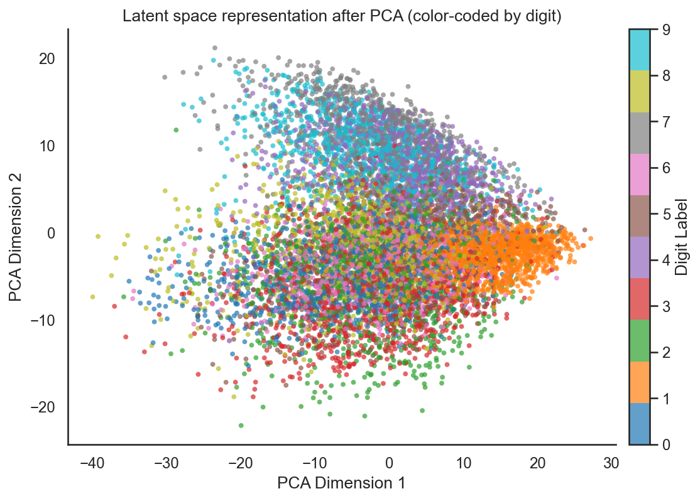
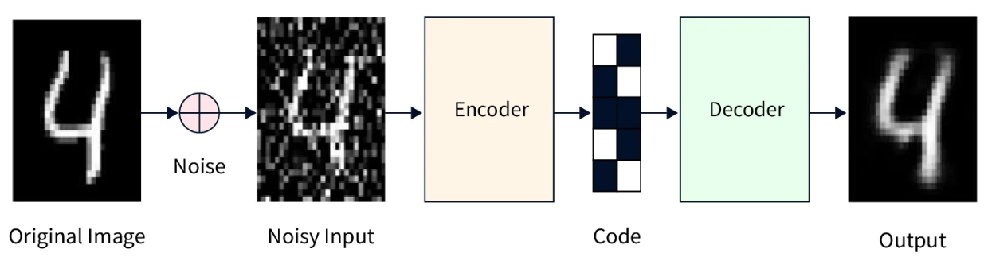
How to use an AE?
We want more than reconstructions; it doesn’t bring us anything.
Visualization / clustering: map high-dimensional data into 2D or 3D, where similar inputs lie close together. MNIST latent-space plots are the standard example.
Denoising: learn a representation that keeps signal but discards noise, so a noisy image can be reconstructed into a cleaner one.
Source:
https://www.fabriziomusacchio.com/teaching/teaching_dimensionality_reduction_in_neuroscience/10_autoencoders
https://www.scaler.com/topics/deep-learning/denoising-autoencoder

Slide 13
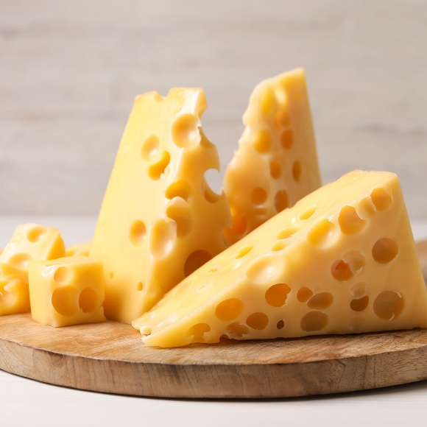
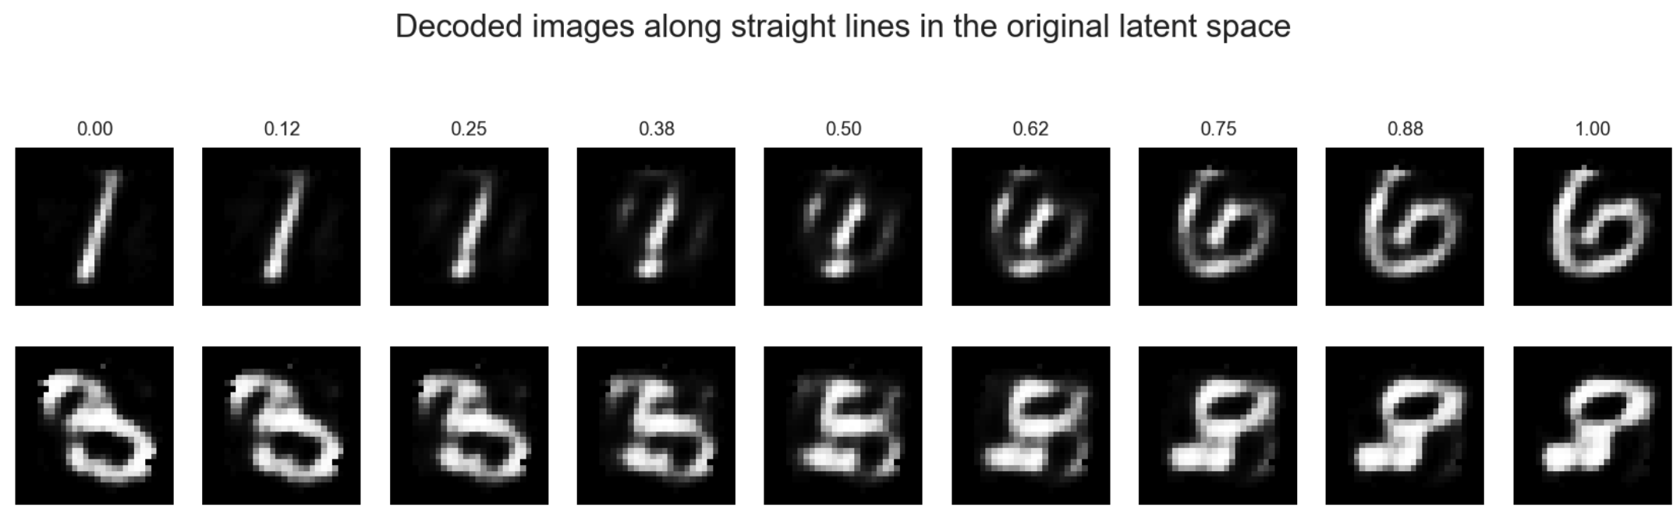
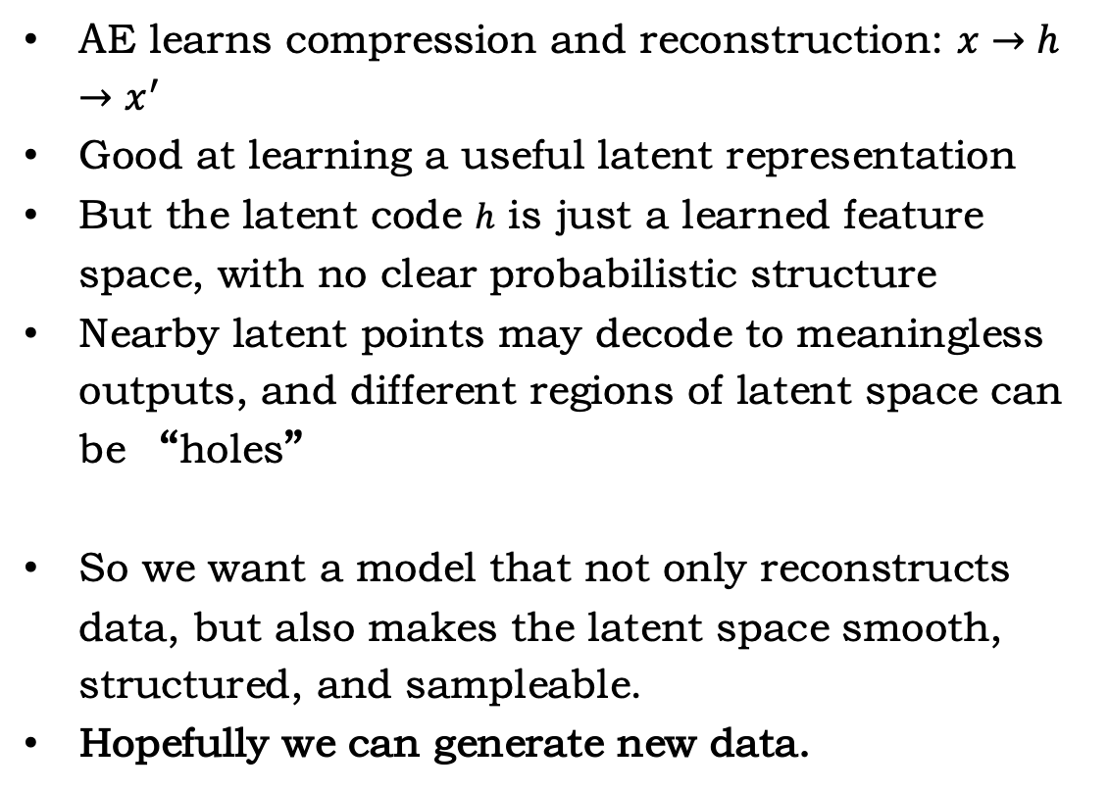
From AE to VAE
AE learns compression and reconstruction: $x→h→x^{′}$
Good at learning a useful latent representation
But the latent code $h$ is just a learned feature space, with no clear probabilistic structure
Nearby latent points may decode to meaningless outputs, and different regions of latent space can be “holes”
So we want a model that not only reconstructs data, but also makes the latent space smooth, structured, and sampleable.
Hopefully we can generate new data.

Slide 14
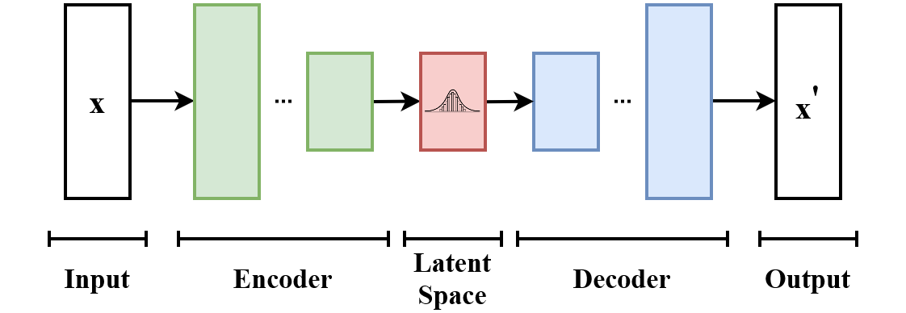
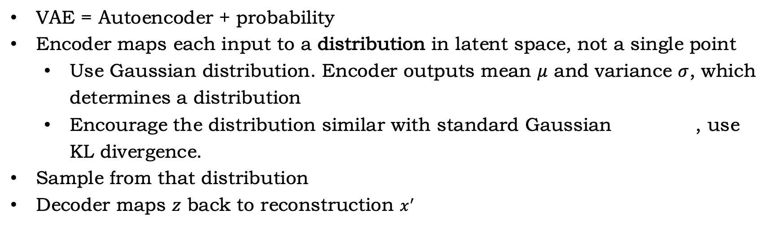
Variational AutoEncoder(VAE)
VAE = Autoencoder + probability
Encoder maps each input to a distribution in latent space, not a single point
  Use Gaussian distribution. Encoder outputs mean $μ$ and variance $σ$, which determines a distribution
  Encourage the distribution similar with standard Gaussian , use KL divergence.
Sample from that distribution
Decoder maps $z$ back to reconstruction $x^{′}$
source: https://en.wikipedia.org/wiki/Variational_autoencoder

Slide 15
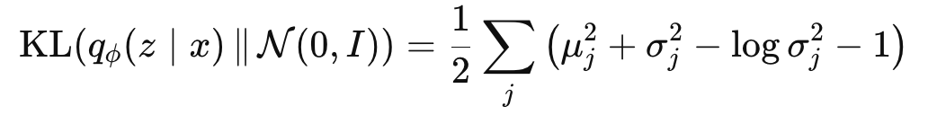
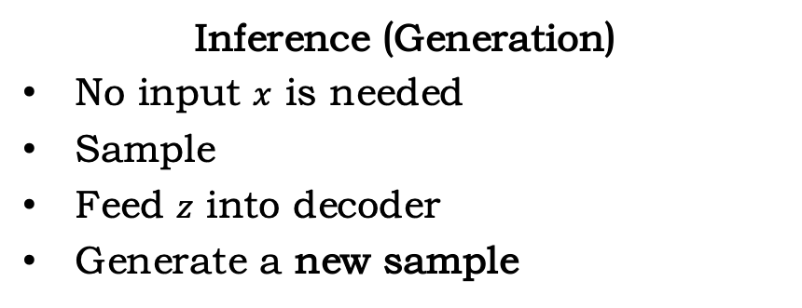
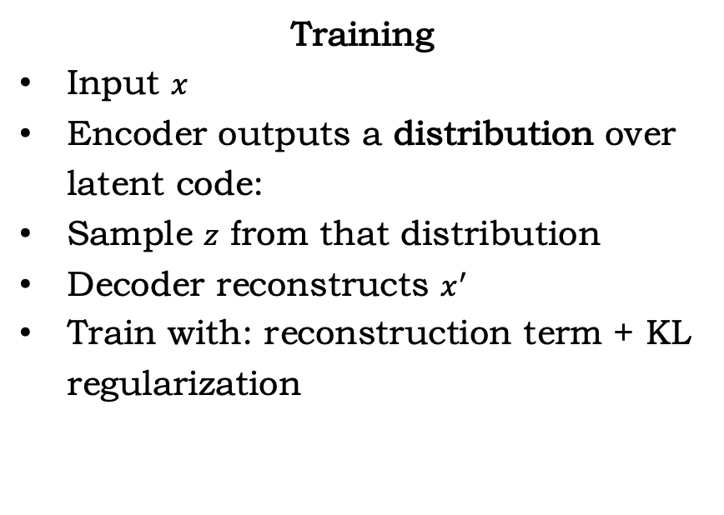
VAE train and inference
Training
Input $x$
Encoder outputs a distribution over latent code:
Sample $z$ from that distribution
Decoder reconstructs $x^{′}$
Train with: reconstruction term + KL regularization
Inference (Generation)
No input $x$ is needed
Sample
Feed $z$ into decoder
Generate a new sample

Slide 16
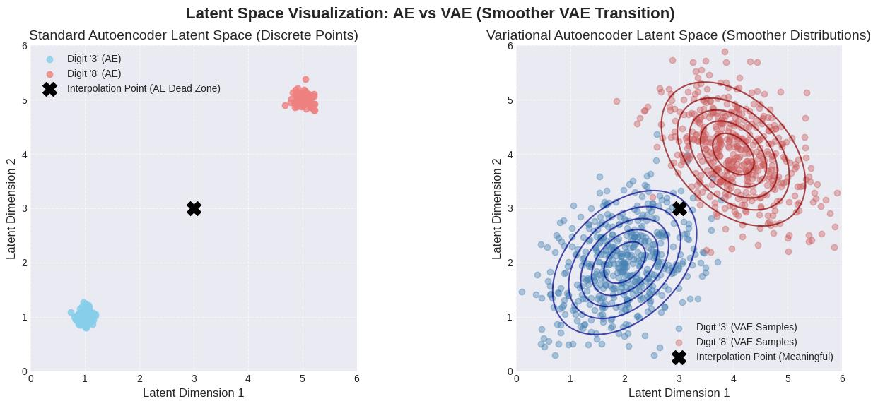
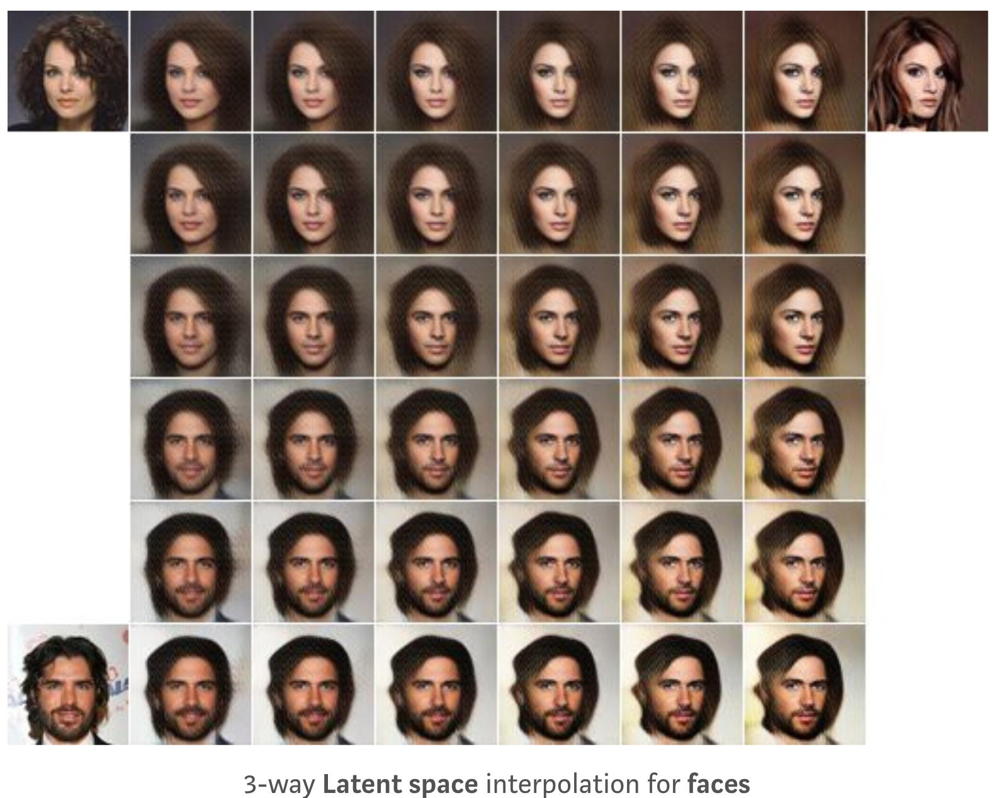
VAE latent space
The latent space of VAE more like a distribution
You can sample from latent, and get better results
source: https://compneuro.neuromatch.io/tutorials/Bonus_Autoencoders/student/Bonus_Tutorial1.html

Slide 17

Conditional Generation
Control what you generate
Introduce condition c(label, cell type, .etc)
So the NN would know what to generate.
Training also need to change
source: https://compneuro.neuromatch.io/tutorials/Bonus_Autoencoders/student/Bonus_Tutorial1.html

Slide 18
Further…
generative_models/01_autoencoder_mnist_latent.ipynb contains code to train an autoencoder using MNIST
generative_models/02_vae_mnist_latent.ipynb trains a VAE
Try by yourself !
Recommended papers:
  https://arxiv.org/abs/1312.6114 (Auto-Encoding Variational Bayes)
  https://arxiv.org/abs/1906.02691 (An Introduction to Variational Autoencoders)
  https://arxiv.org/abs/1711.00937 (VQ-VAE)
  https://web.stanford.edu/class/cs294a/sparseAutoencoder.pdf (SAE)

Slide 19
Gene Expression Data and Protein Data

Slide 20
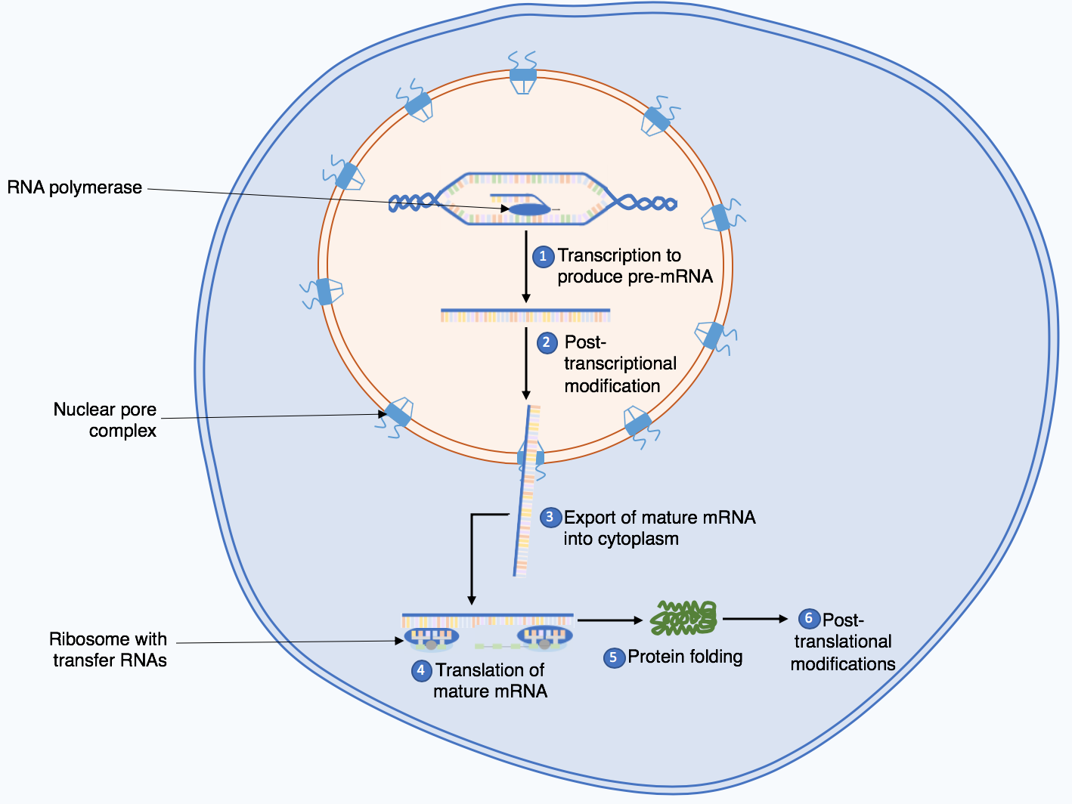
Recap: central dogma
Source: Wikipedia
Notes:
https://statomics.github.io/SGA/sequencing_intro.html

Slide 21
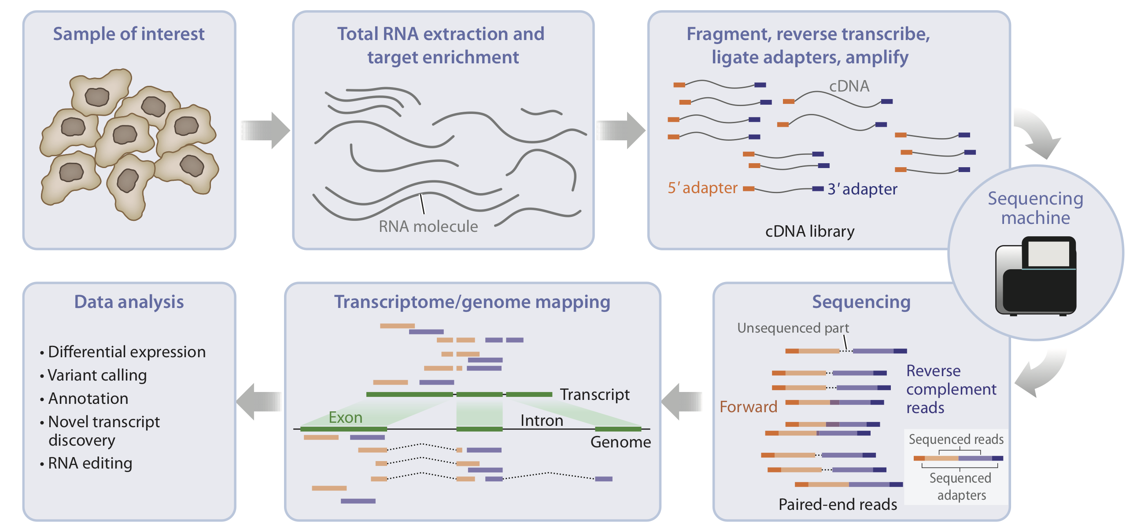
RNA sequencing
Source: Van den Berge et al. (2019)

Slide 22
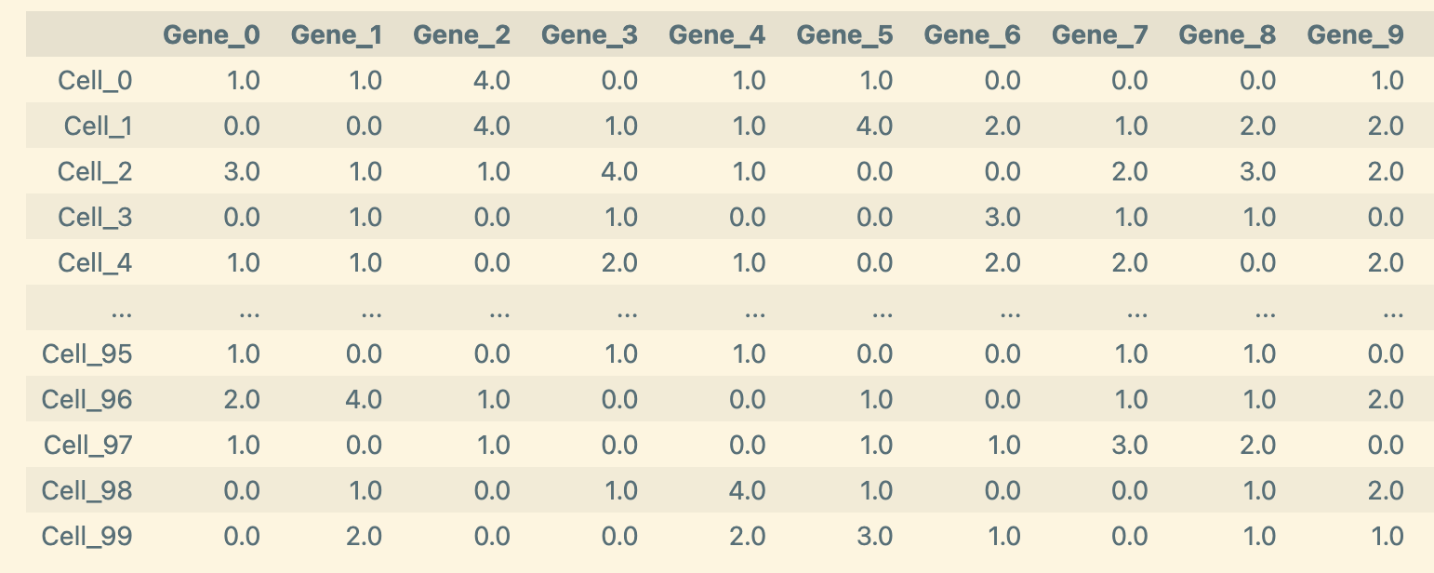
RNA-seq data: Anndata
Rows correspond to cells.
Columns correspond to genes.
Each entry is the raw count observed for one gene in one cell.

Slide 23
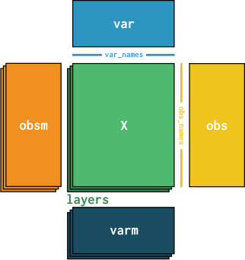
RNA-seq data: Anndata
X is the main matrix, cells x genes
Obs stores cell-level metadata. Celltype, batch, condition, .etc
Var stores gene-level metadata. E.g. gene name, chromosome, .etc
Obsm stores a vector for each cell. A common example is adata.obsm["X_pca"]
Varm stores a vector for each gene. Most common is adata.varm["PCs"] (PCA loading)
Layers stores other version of X, with same shape. E.g. raw counts, normalized counts, log1p-transformed values, .etc
Source: https://www.sc-best-practices.org/ (very recommended!)

Slide 24
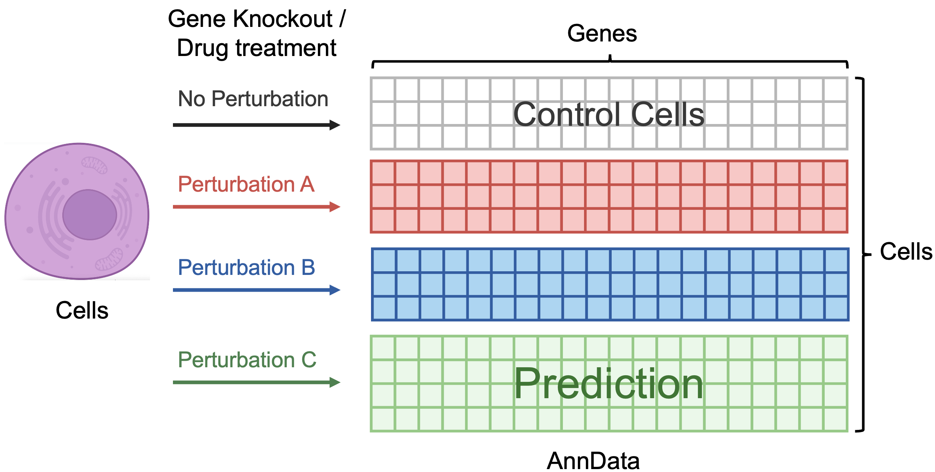
Perturb-Seq data
Traditional single-cell RNA-seq is mainly observational: it shows associations, but not necessarily causality.
Perturb-seq adds controlled interventions and measures how cells respond after perturbation.
This helps us identify which genes drive specific cellular programs and how perturbations reshape cell states.

Slide 25

Application: scVI
scRNA-seq gives a gene expression vector for each cell:
The observed counts are noisy, sparse, and affected by technical factors.
Important nuisance factors include:
  sequencing depth / library size
  batch effects
  dropout / limited sensitivity
Goal: learn a low-dimensional biological representation while accounting for technical noise.

Slide 26
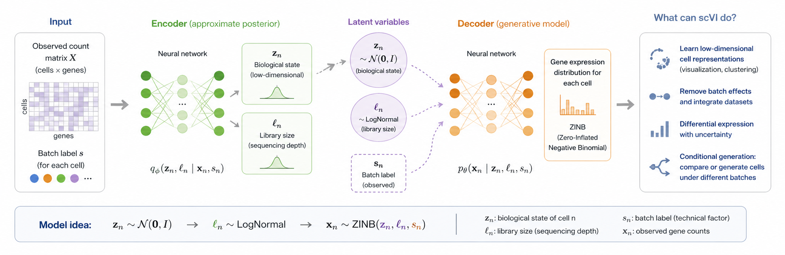
Application: scVI

Slide 27
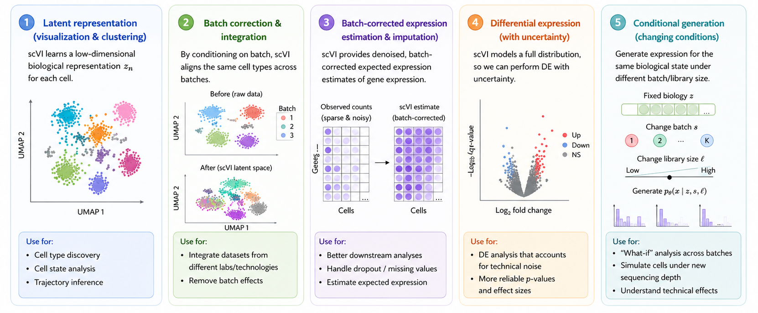
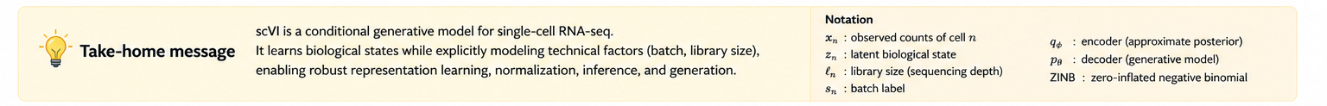
What can it do

Slide 28


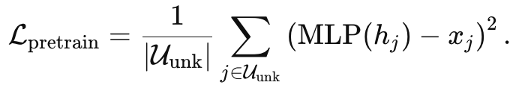
scGPT
Predict gene expression given other gene expression and condition
First, turn gene and gene expression into tokens
Then turn conditions (cell type, perturbation) into token embeddings, and add all three together
M is number of genes in a cell, D is embedding dim
Randomly mask some gene expression in the cell, let model predict it.

Slide 29
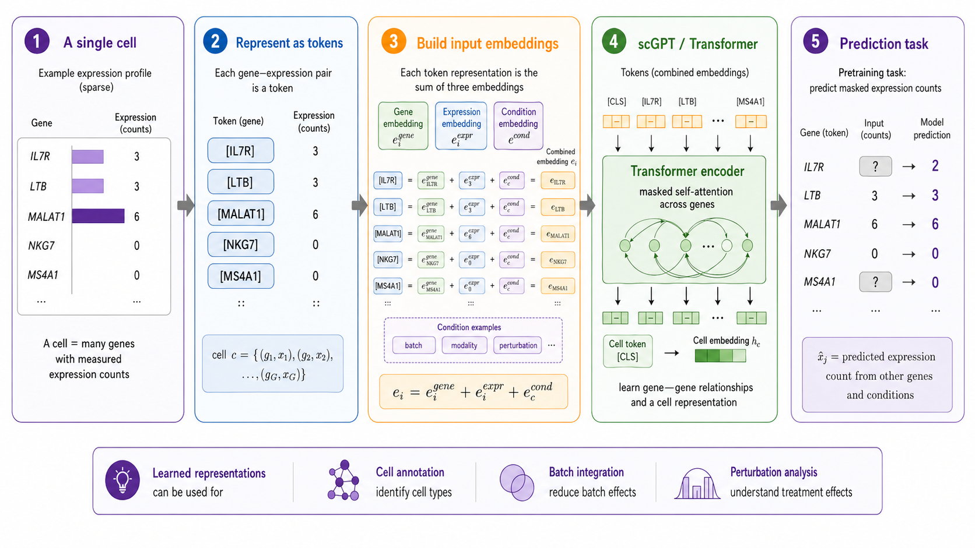
scGPT

Slide 30
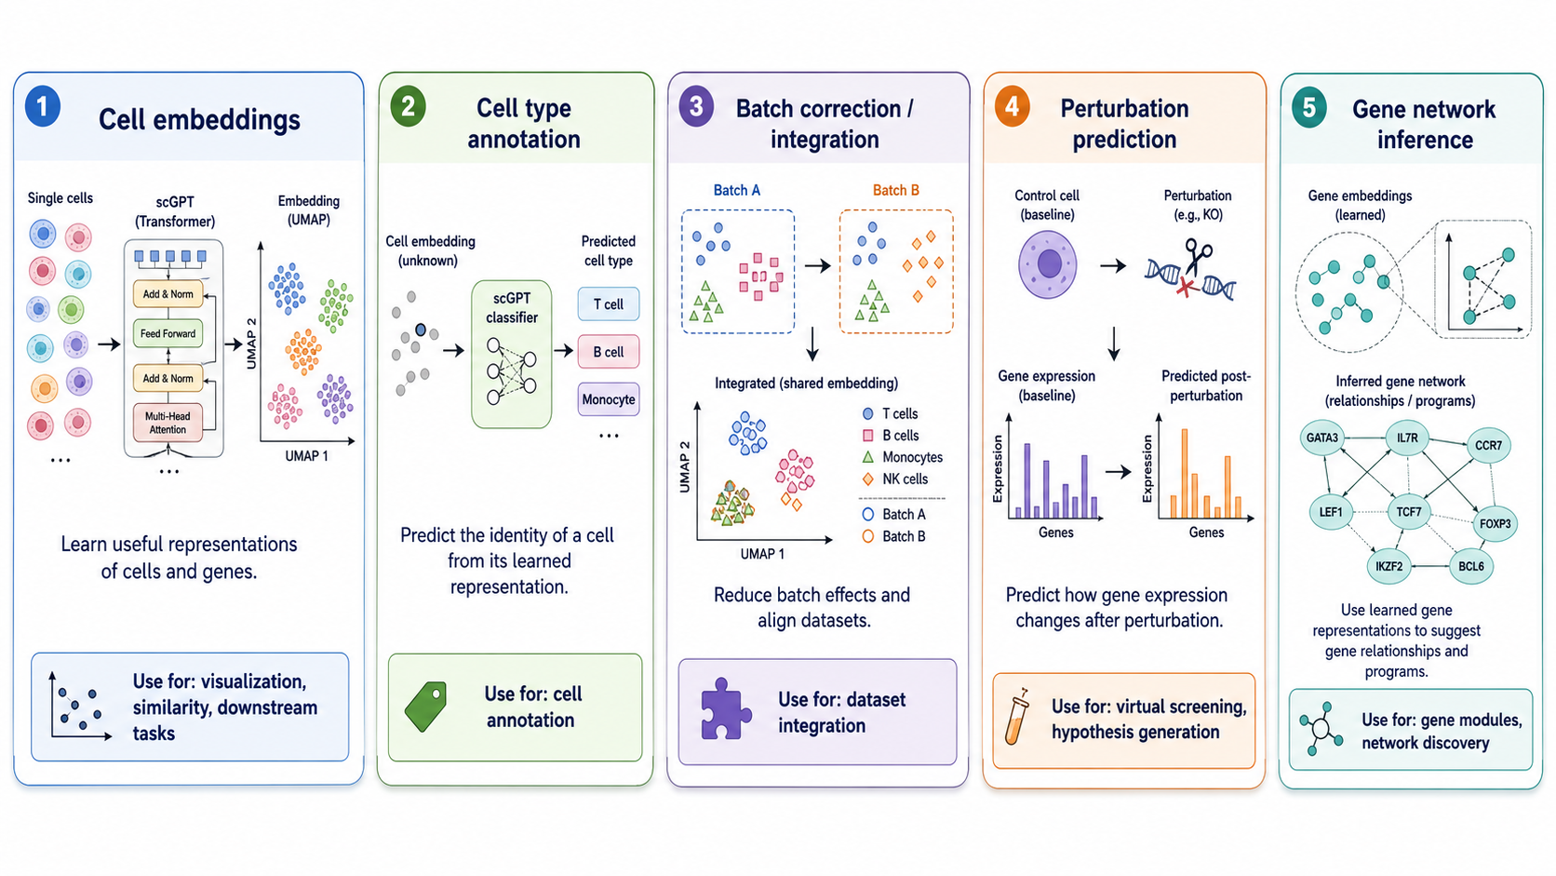
What can scGPT do
Apart from perturbation prediction, all others are done based on its embedding.

Slide 31
Further…
Since training a small GPT that can say something need GPU, so we just provide a demo: generative_models/03_toy_gpt_forward_generation.ipynb
Try HappyLLM if you want to train your own
Recommended resources:
  https://web.stanford.edu/class/cs25/ Most recommended. You can get an overview of most advanced technologies.
  https://arxiv.org/abs/1706.03762 (Attention Is All You Need)
  https://github.com/datawhalechina/happy-llm (Train a llm by yourself)
  https://web.stanford.edu/class/cs224n/ (Natural Language Processing with Deep Learning)
  https://cs336.stanford.edu/ (Language Modeling from Scratch)
    Hard, learn cs224n/happyllm first.

Slide 32

Diffusion Models

Slide 33

Diffusion in Physics
Ink diffuses in water over time
Image source: https://makeagif.com/gif/ink-drip-in-water-stock-footage-red-toobstock-free-stock-video-IR7ZXe

Slide 34
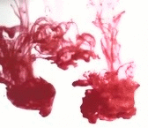
Diffusion in Physics
Ink diffuses in water over time
What if we can reverse time?

Slide 35

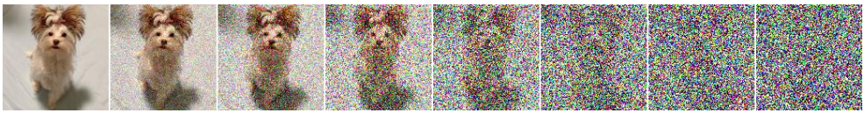
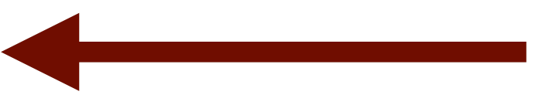
Diffusion-based models
Add Markovian Gaussian noise
  Data distribution
  Gaussian noise
  Model distribution
  Gaussian prior
Learn to denoise/generate data

Slide 36
Core idea of diffusion model
Training: Learn to predict image from noisy image
Sampling: sample from gaussian noise and then turn into image gradually.

Slide 37

Diffusion Training
Add Gaussian noise
  Data distribution
  Gaussian noise
  Model
  distribution
  Gaussian prior
Learn to recover clean data

Slide 38
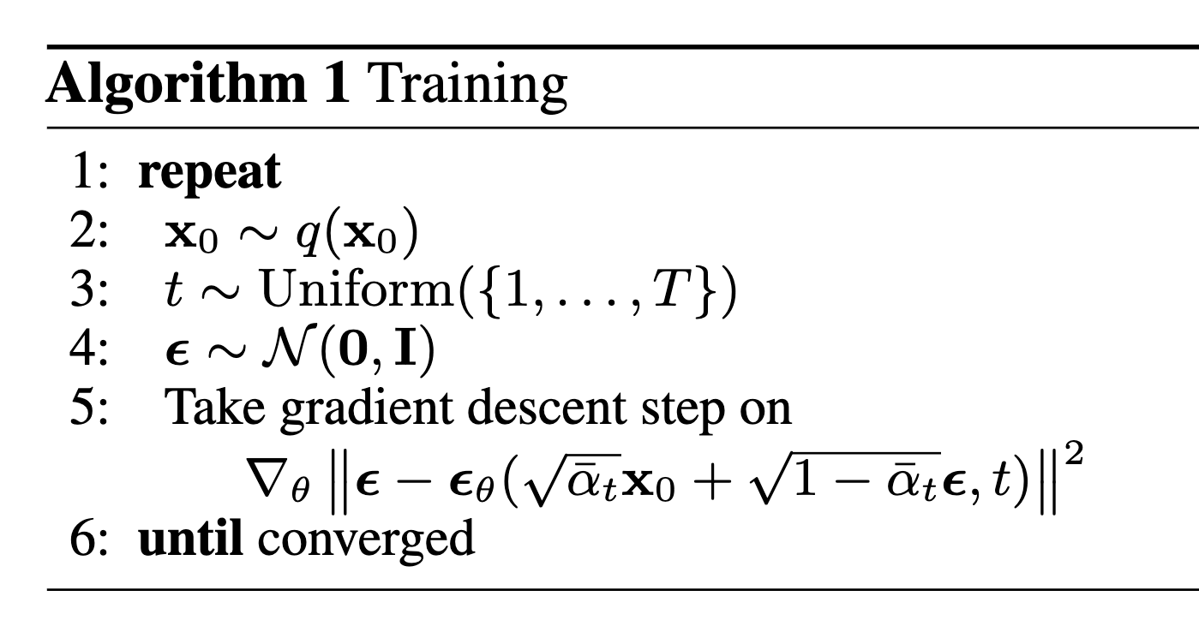
Diffusion Training
Since , $x_{0}$ prediction is equivalent to $ε$ prediction.
t=0 is clean image, t=T(e.g. 100) is pure gaussian noise.
$α$ schedule is pre-determined.

Slide 39


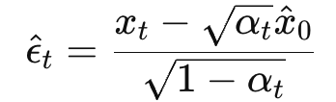

Diffusion sampling
Sampling starts from pure noise and repeatedly applies this learned denoising rule.
Current noisy sample:
Predict clean sample:
Estimate noise inside $x_{t}$, (since )
Move to a cleaner noise level
Iterate until t=0.

Slide 40
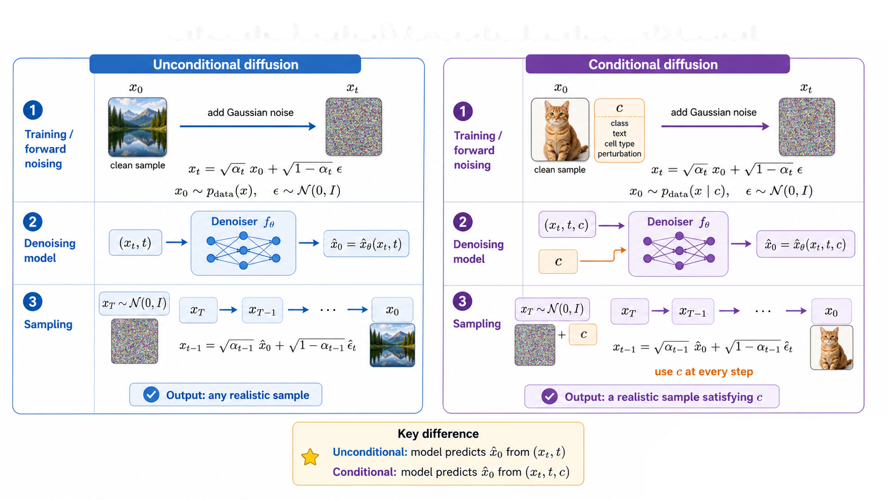
Conditional Diffusion

Slide 41
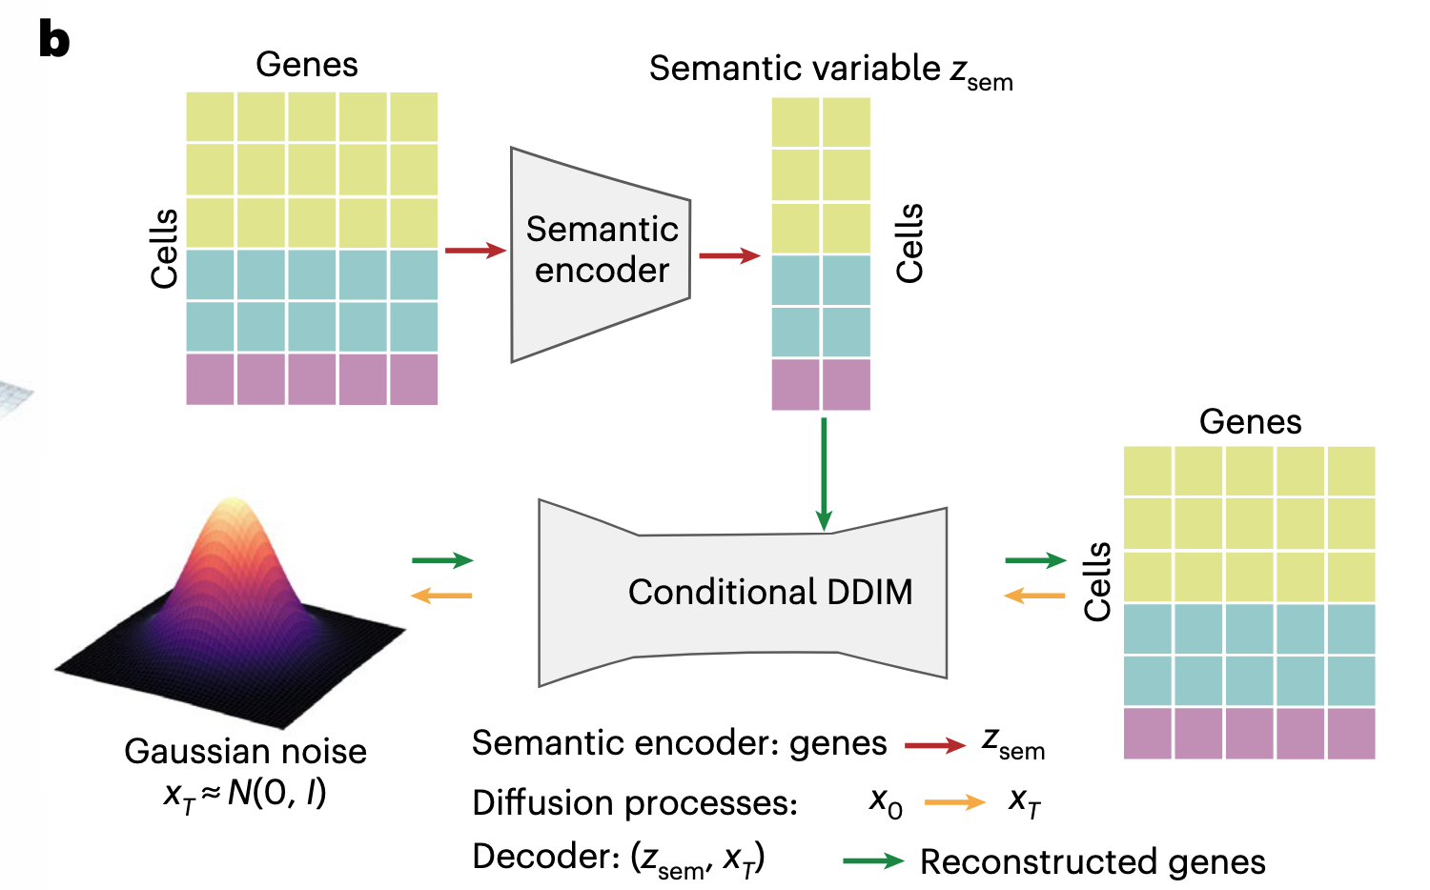
Application: Squidiff
He, Siyu, et al. "Squidiff: predicting cellular development and responses to perturbations using a diffusion model." Nature methods 23.1 (2026): 65-77.

